Slide 1



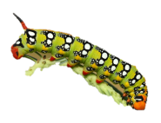


Municipal state-owned enterprise «Nursery-garden «Tansholpan» of education department of Balkhash city of education department of Karaganda region
SOFTWARE OF THE WEEK
«NATURAL COGNITIVE LITERACY»

Slide 2
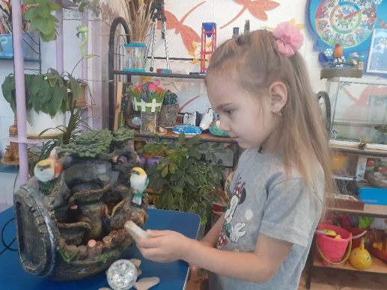
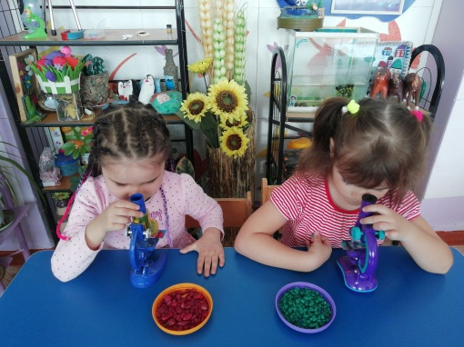
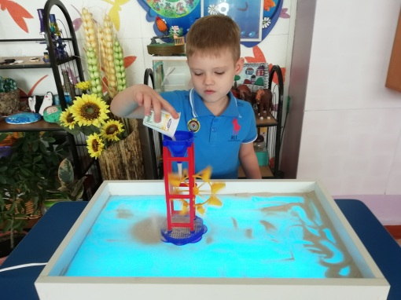
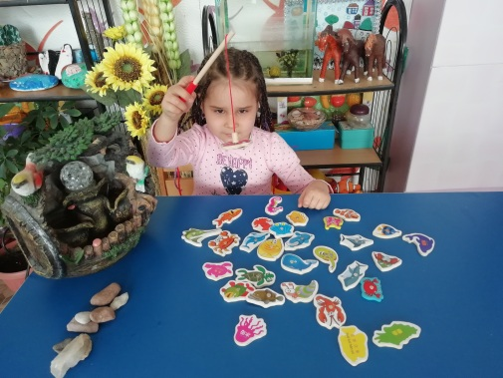
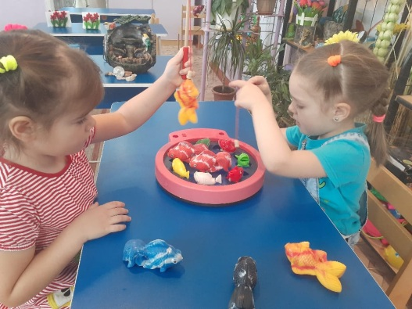
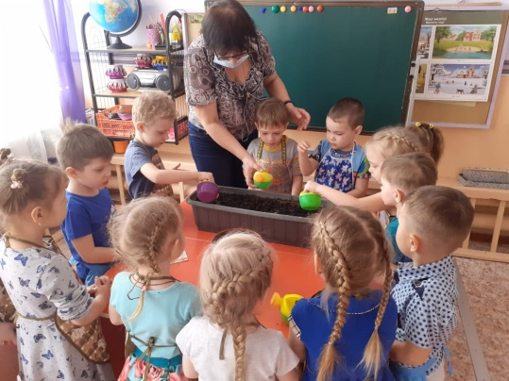
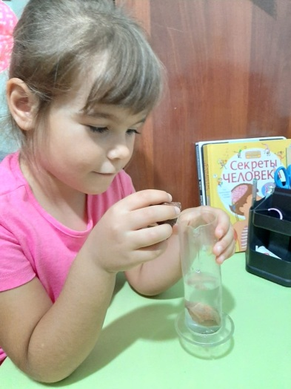
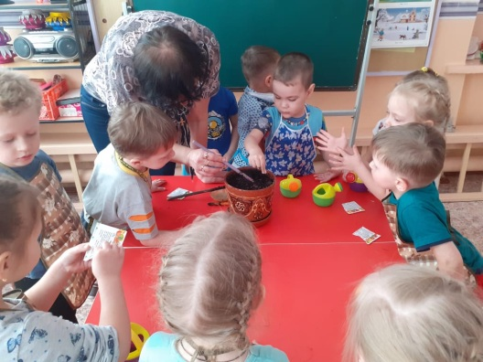
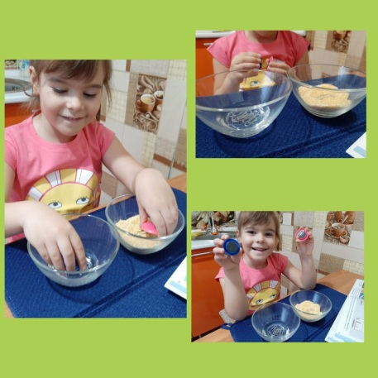
hashtag # amazing near # krg The educational and methodological center of Karaganda launched the project of the week "Natural cognitive literacy." As part of the first day, under the motto, the day of suprices and mysteries "Unusual Nearby" in the Tansholpan Nursery Garden with the aim of forming natural-cognitive needs, developing research interest and creativity in the process of practical knowledge.
Educators offered children various experiments and experiments "How potatoes got to our table," "Why stones sink," "Stones are different" logical games "Magic buttons and staples," observations "Riddles of Frost Ivanovich," "Measuring devices." Received feedback from parents at home "Entertaining Games and Exercises." The "Day of Knowledge" gave the children many joyful discoveries, wonderful minutes of communication, love for the generous and amazing world around us.

Slide 3
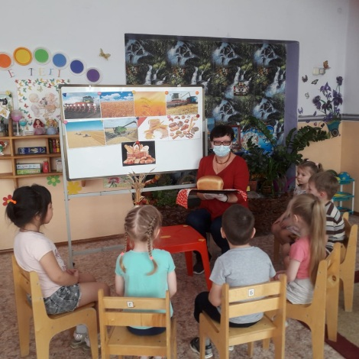
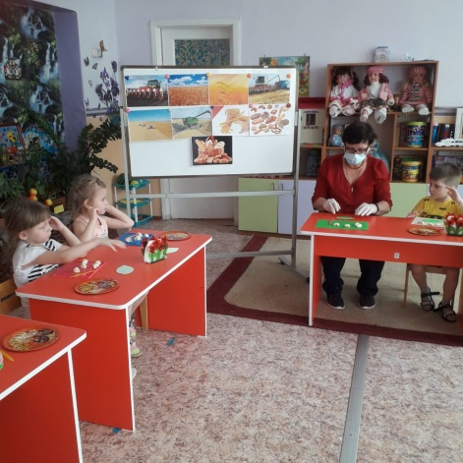
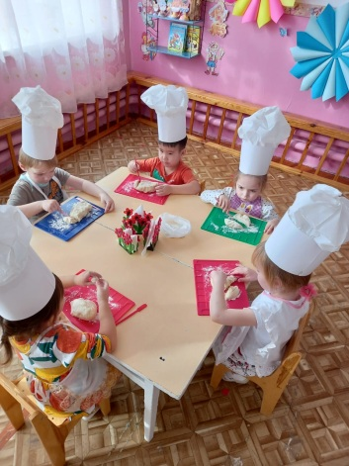
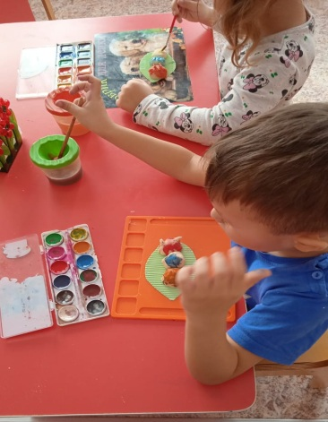
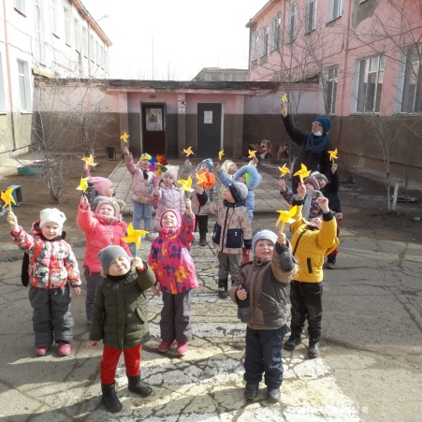
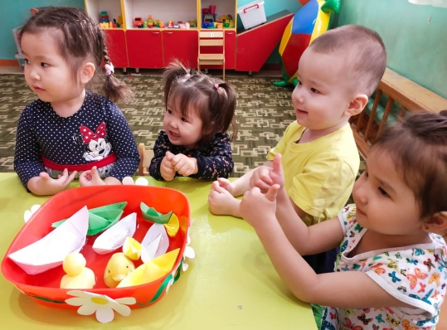
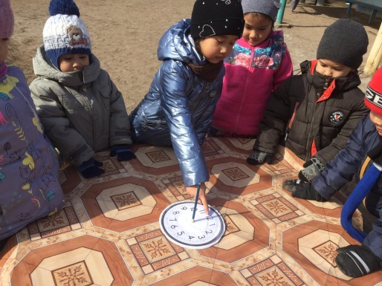
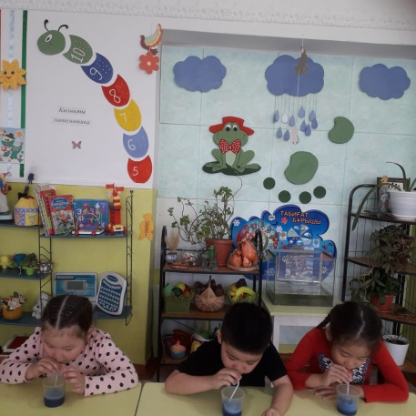
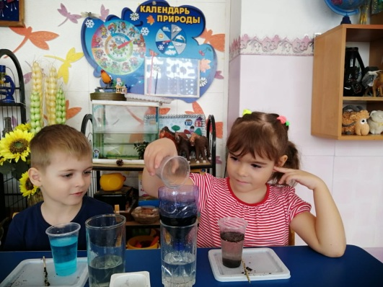
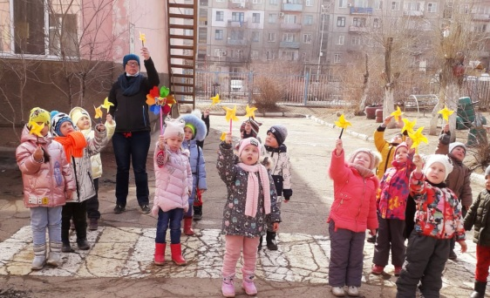
As part of the second day of the thematic week, under the motto "Little Explorers" experimentation day at Tansholpan Nursery Garden with the goal of developing abilities for practical and mental experimentation, accumulating "baggage" of research skills, mastering various ways of knowing the world around you, thinking operations. The idea of ​ ​ holding a thematic day is based on the reception of immersion of children in a specific topic. The pupils learned "Where did the bread come from?," "Properties of the dough" (they sculpted caterpillar from the dough, cakes), conducted experiments: "Magnet test," "Clean the water," "Where did the ship swim." On the walk, the direction of the wind was determined. Children got the joy of communicating with each other, showed creative activity.

Slide 4
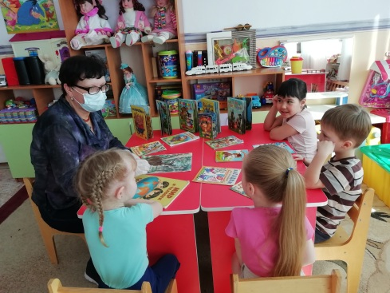
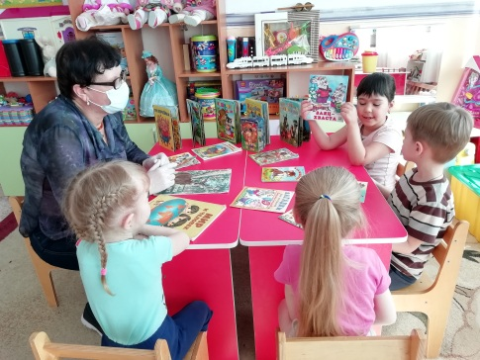
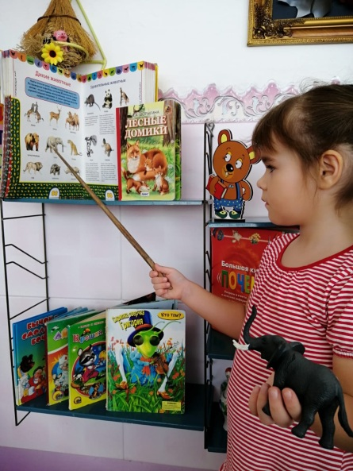
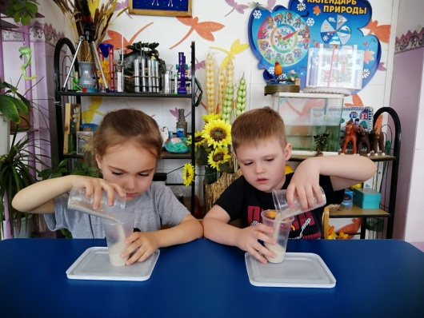
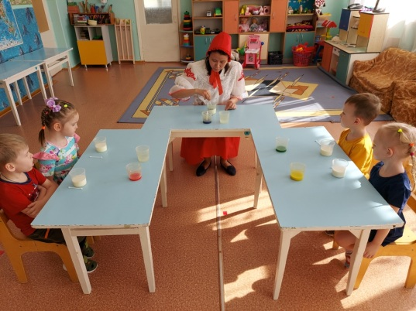
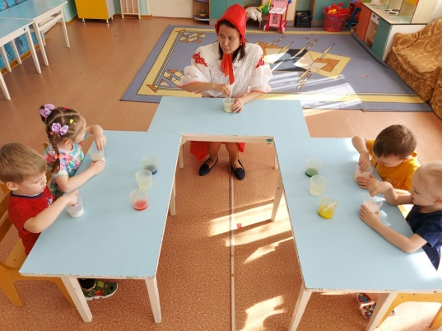
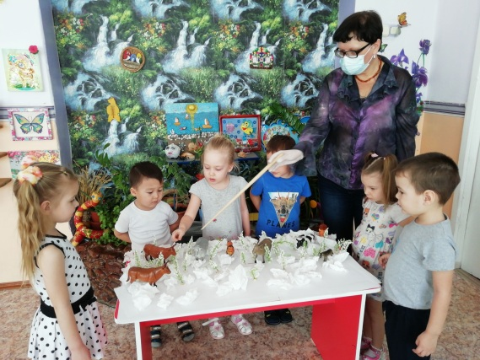
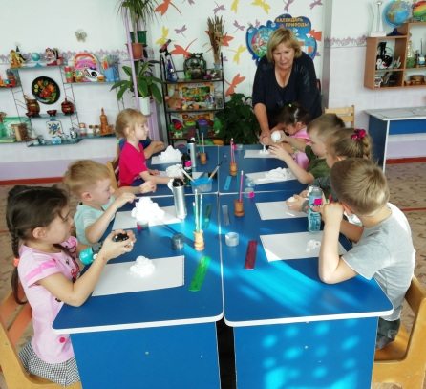
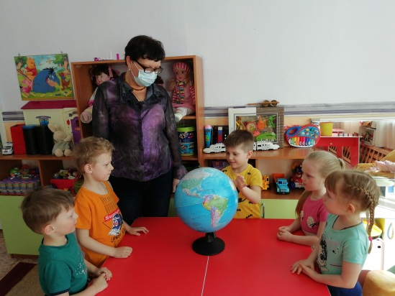
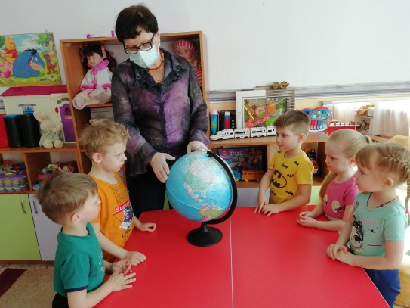
As part of the third day of the thematic week under the motto Day of Tracers and Interesting Discoveries "Adventurers" in the "Nursery Garden" Tansholpan "in order to create conditions for the development of cognitive activity and curiosity of preschoolers in the process of experimentation and research; in all age groups, at a level accessible to children, the following were held: thematic exhibitions "I want to know everything," experimental activities "Visiting the Red Riding Hood," a round-the-world trip around the globe, "Meeting in the winter forest," children were happy to study sand: determined composition, looseness.

Slide 5
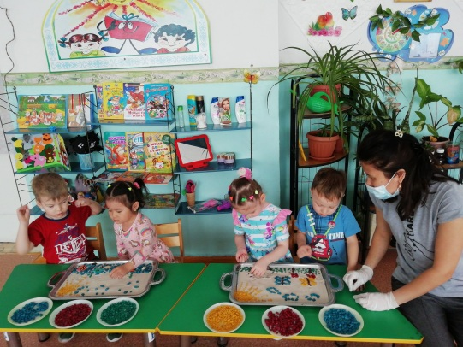
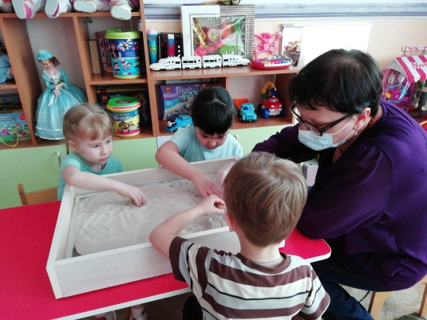
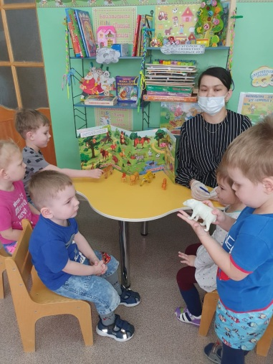
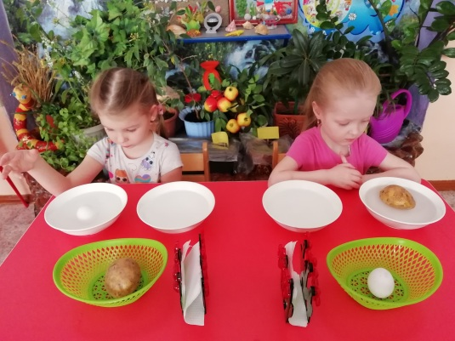
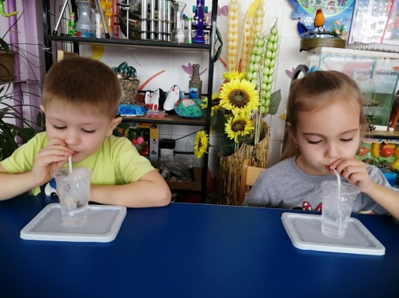
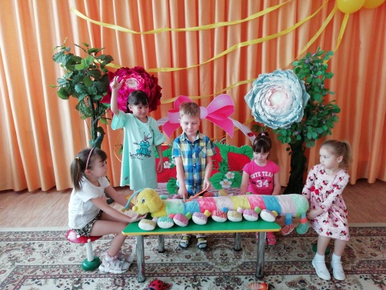
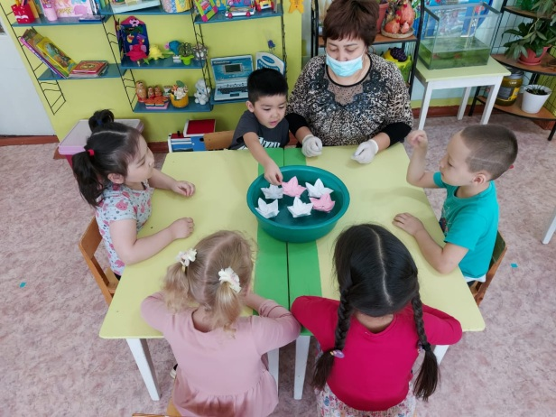
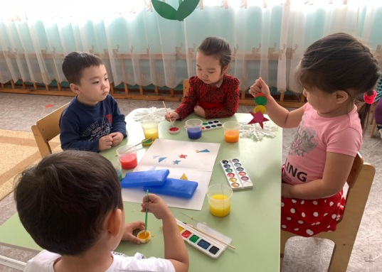
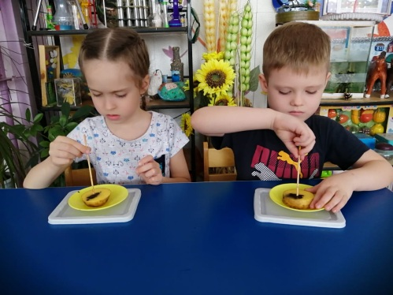
As part of the fourth day of the thematic week, under the motto Day of quizzes and entertaining games "Visiting Pochemuchka" in the Tansholpan Nursery Garden, the children learned a lot of new and interesting things. The guys with the teachers in the group conducted many new experiments and discoveries, with sand, air, water. Children really liked the unconventional technique of painting with colored pebbles on sand, looking for treasures in the sand, getting a coin out of the container without soaking their hands, watching as potatoes, an egg rises from the bottom of the container. With what delight the children watched the "lotus flower" bloom in the water. With this experience, they saw that plants need water to live. Children could independently take part in the experiments "Erupting Volcano," a magnet test, which will be if they drop iodine on potatoes, add oil to the water at home. With confidence, the day of entertaining games was successful and productive!

Slide 6
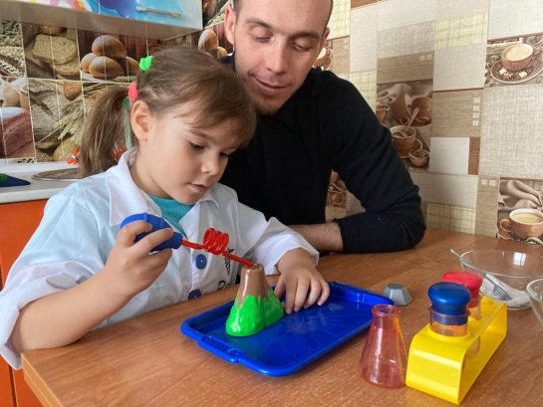
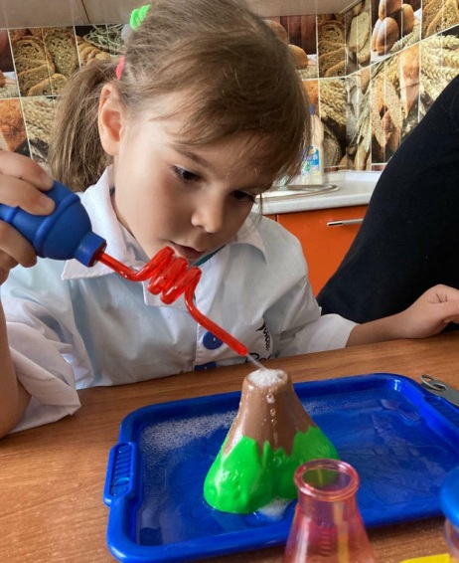
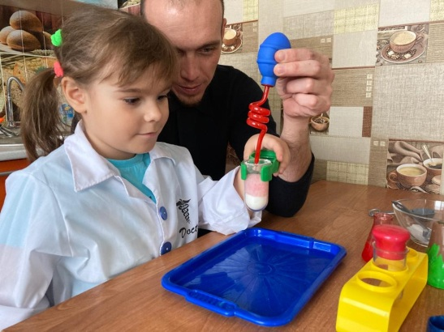
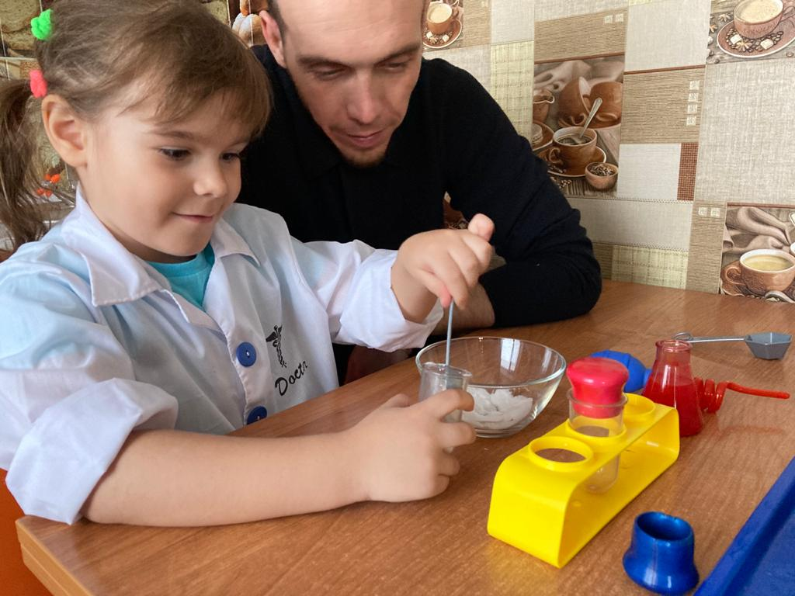
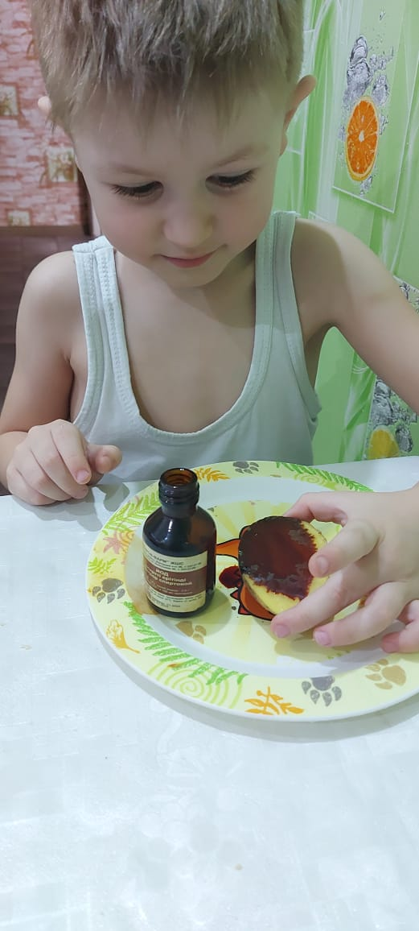
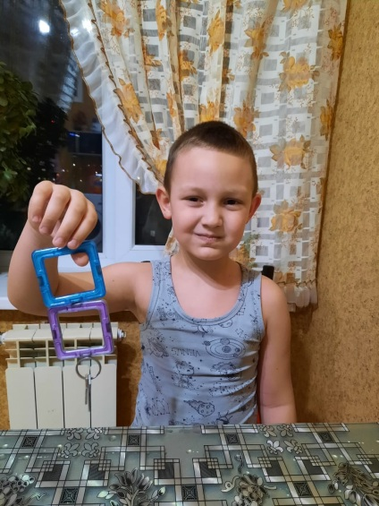

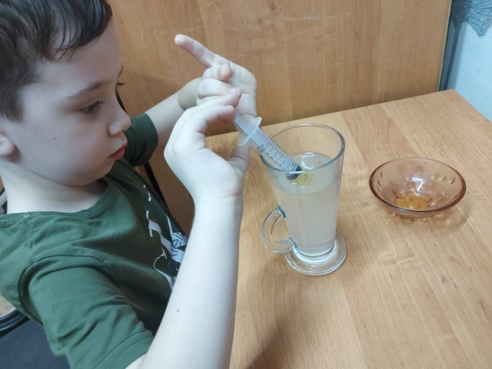
Feedback from parents
Children could independently take part in experiments at home, conclude: "Erupting volcano," a magnet test, analyzed: what if iodine drips on potatoes, or add oil to the water.

Slide 7
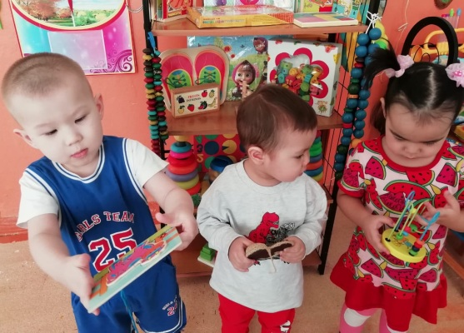
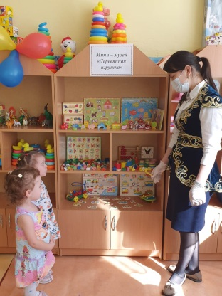
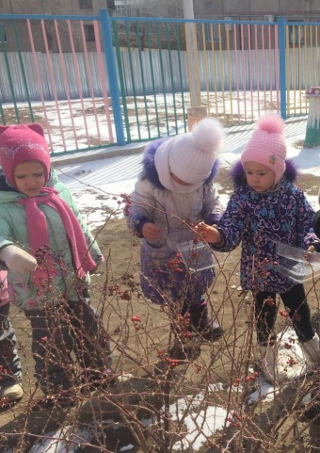
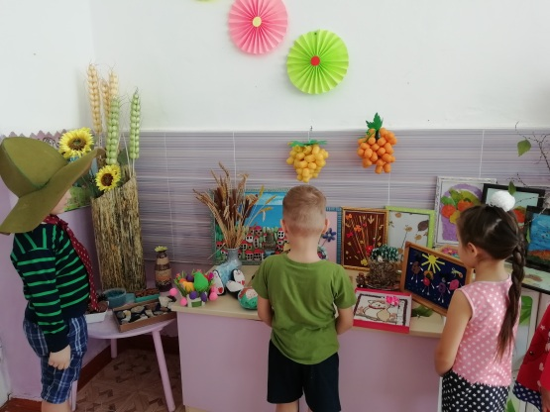








The closing of the week under the motto Day of Collectors "Cave of Treasures" in the "Nursery Garden" Tansholpan "day reflected various forms and methods of educational work: a tour of mini-museums of the collections "Stones are Different," "Wooden Toy," a targeted walk "We will collect a collection for creativity" (collection of natural and catchy material), children's production of works with natural and catchy material, a folder-screen with recommendations for the organization of a corner of experimentation "Children's Laboratory" was designed for teachers, an online consultation with the participation of parents "We experiment with a child On such a good note, the thematic week on natural cognitive literacy ended.

