Slide 1
Municipal state-owned enterprise "Nursery-garden" Tansholpan "of education department of Balkhash city of education department of Karaganda region
"The fate of the language suggests that I am a citizen of Kazakhstan
the common cause of all who believe "
Nazarbayev N.A.
Kazakh language
"Learning Kazakh"

Slide 2
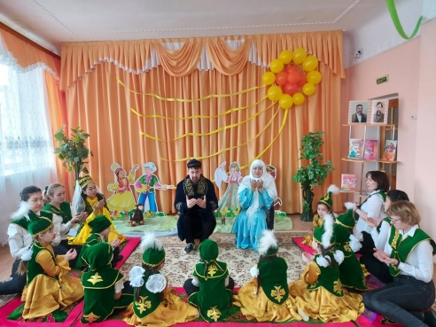
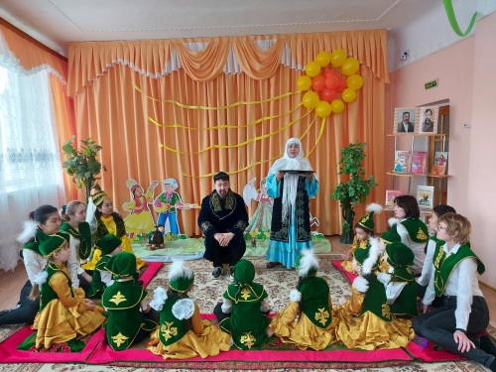
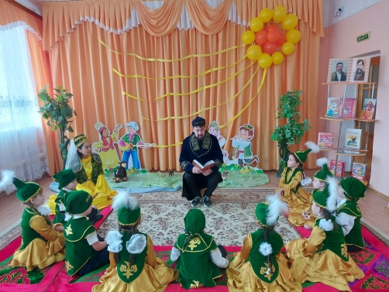
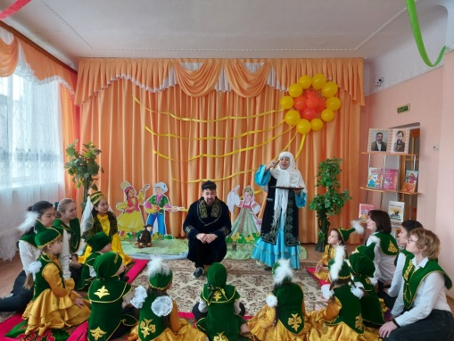
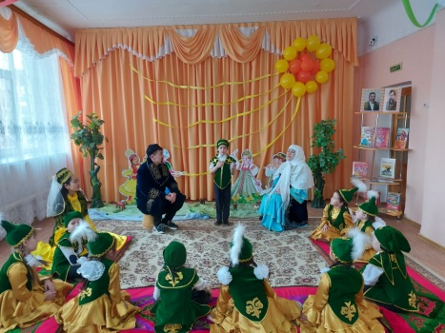
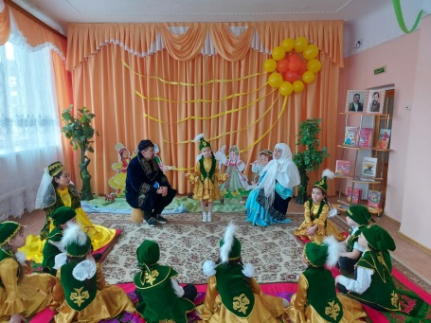
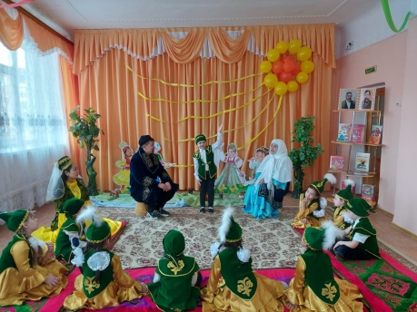
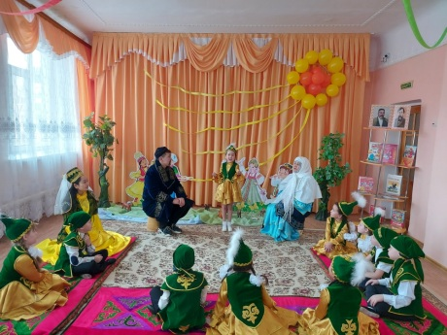
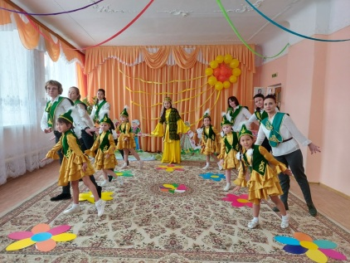
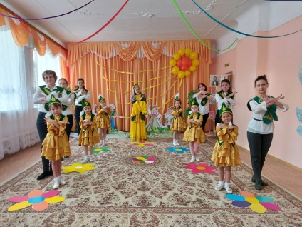
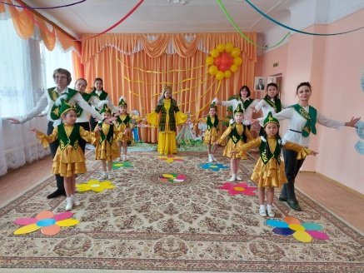
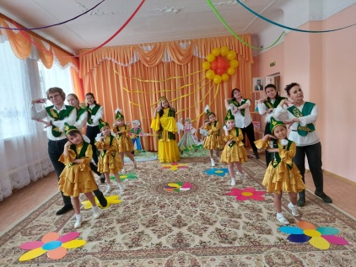
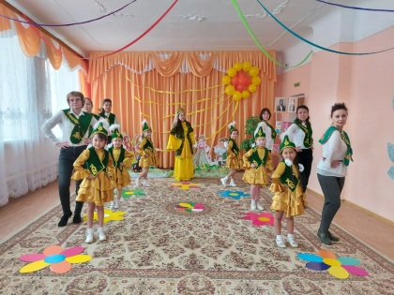
Educational and methodological center of Karaganda reserve project "We study Kazakh yash" in order to continue work on writing, promotion of language culture, popularization of state writing. Within the framework of the first thematic day in the "Nursery - Garden" "Tansholpan" was created at the week "Language - support, beating the heart" and this year motivation events were held to form a deep study of Kazakh writing. In addition, Abaya Kunanbayeva spoke about the Kazakh language, aka bata, steppe piety and adolescence. Competitions were held at which great poets, participants of the Great Steppe and the wealth of the Kazakh language were noted. Opening of the Kazakh pagan flash mob "Kara Zhorg."

Slide 3
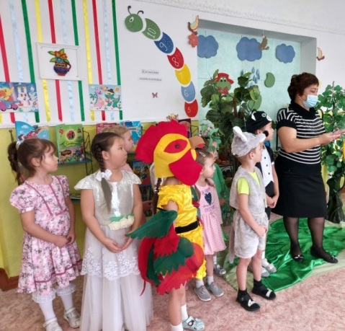
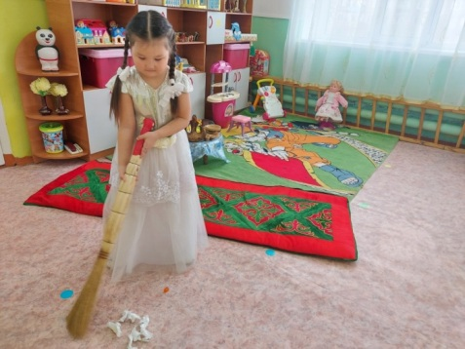
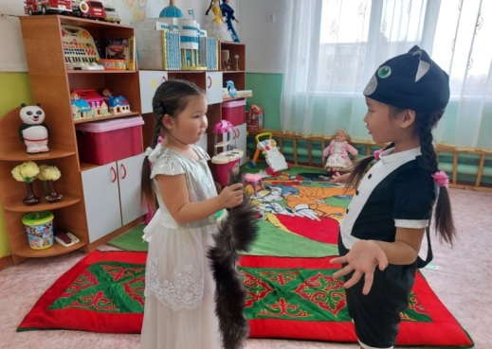
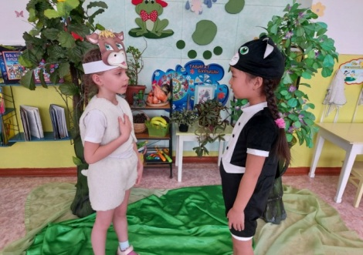
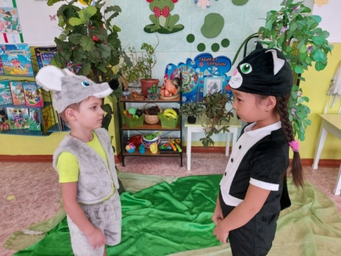
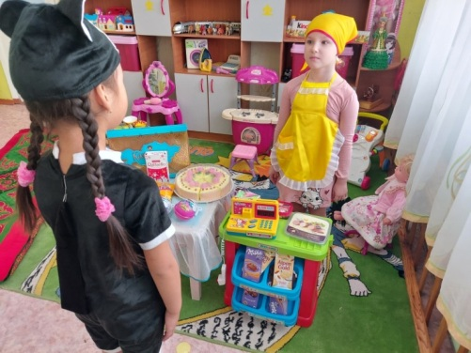
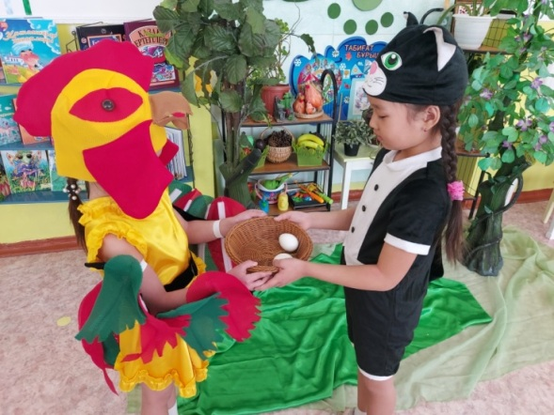
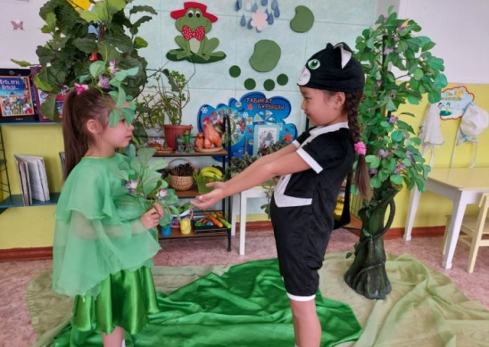
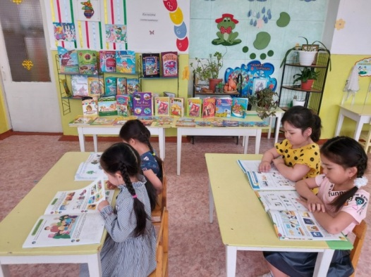
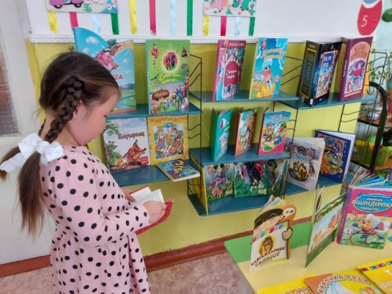
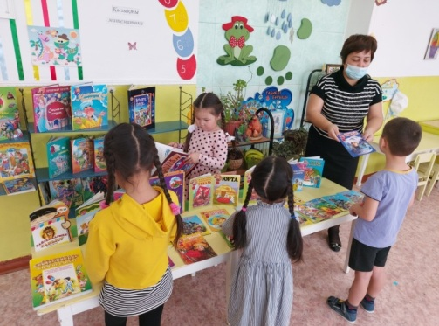
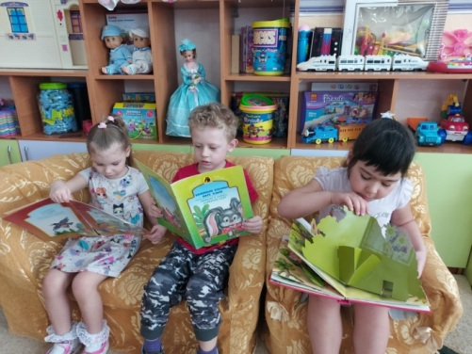
As part of the second day of the thematic week "We study the Kazakh language" in "Nursery - Tansholpan Garden" in order to instill interest in the study of the Kazakh language, the development of creative abilities, the children of the pre-school group showed dramatization of the fairy tale "Cat with a cotton girl." The thematic exhibition "My First Books" was organized. All events were held in a festive solemn atmosphere.

Slide 4
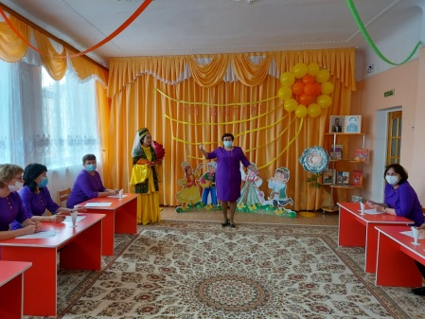
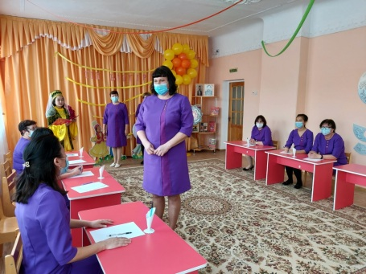
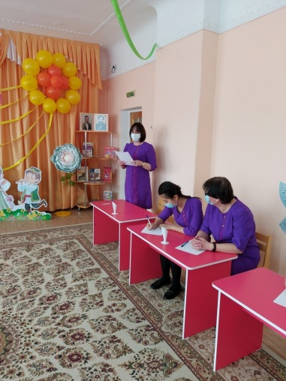
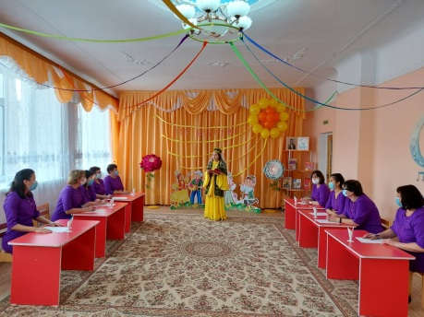
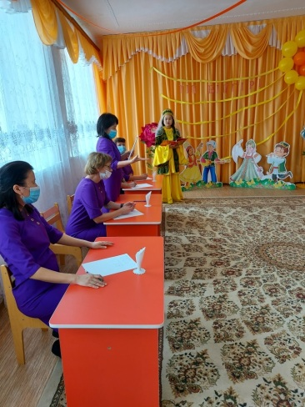
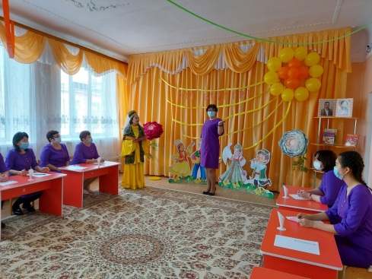
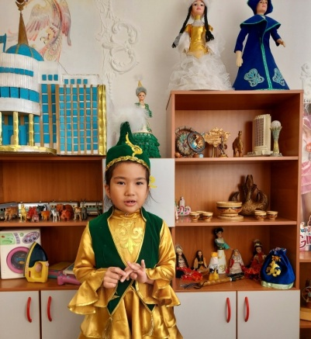
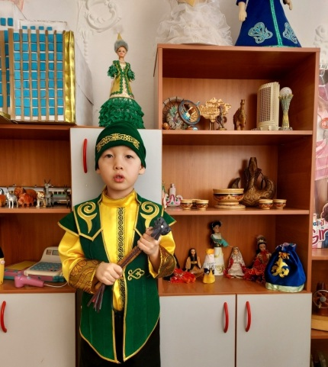
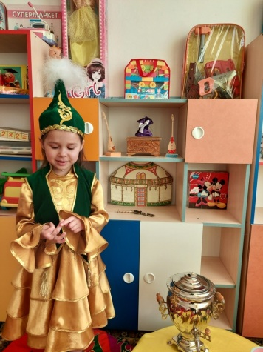
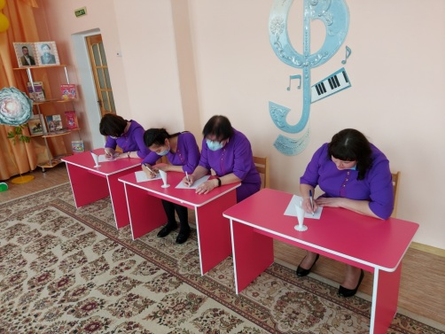
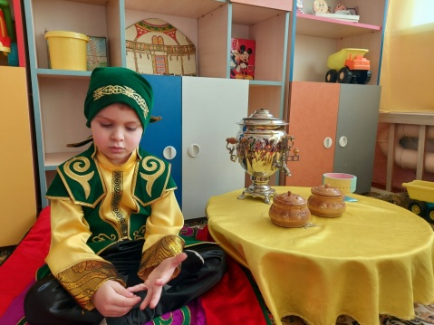
Within the day before yesterday thematic week under the motto ""In recent competitions"" in "A day nursery - the garden "Tansholpan" among teachers there took place the competition "A connoisseur of the language "" for the purpose of instilling at teachers of interest in learning Kazakh where teachers read verses of Abay by Kunanbayev, I. Altynsarina proverbs and sayings told, were able to answer a question quickly. As a result of the competition, teachers received satisfaction from successful answers, from interesting and cognitive tasks. Children of the pre-school group competed in a competition of proverbs, readers, speechless speakers. I would like to note the high activity and interest of preschoolers.

Slide 5
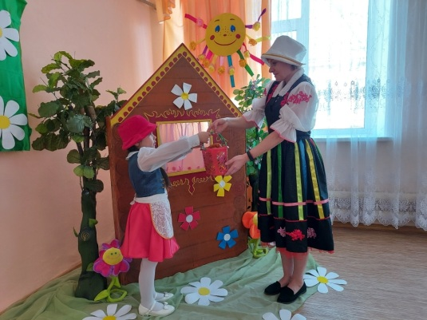
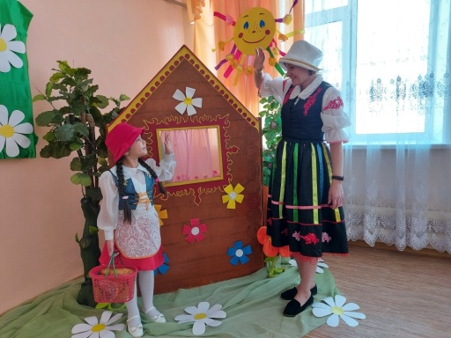
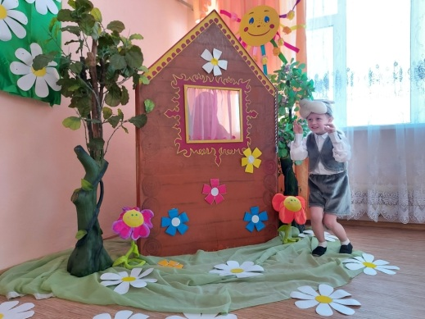
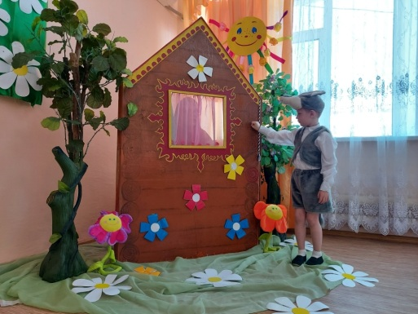
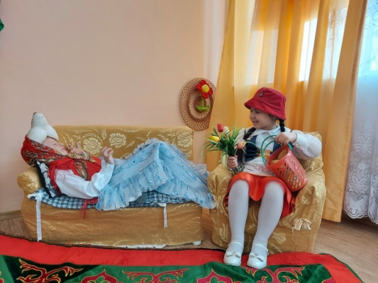
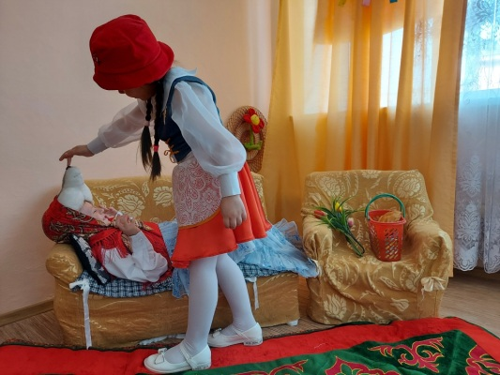
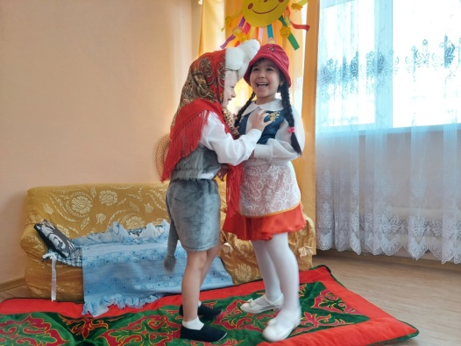
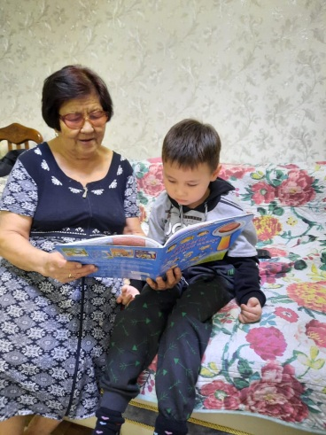
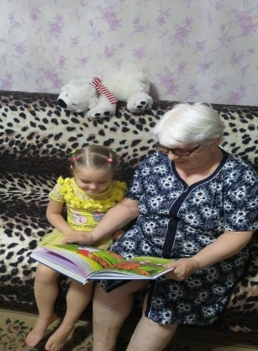
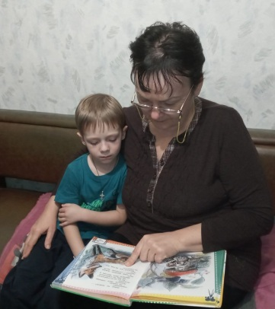
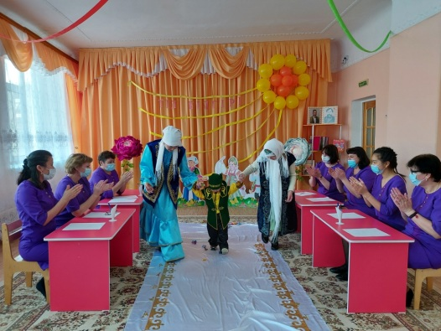
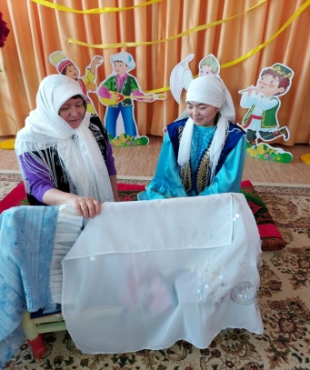
As part of the fourth day of the thematic week, under the motto "Grandmothers of fairy tales" in "Nursery - Tansholpan Garden," interesting events were held aimed at forming the motivation for deeper study of the Kazakh language. A theatrical performance of the fairy tale "ceremony "Red Hat"" was presented by the children of the older group, all the guys approached the task creatively, tried to play like real artists. The active participation of grandmothers made a huge impression in order to teach the child to communicate elementary in the Kazakh language, they showed initiative and creativity in implementation. Teachers of kindergarten took part in carrying out ceremonies of the Kazakh people ""Tusau Caeser,"", ""Laying in the cradle,"" for the purpose of ability to work in team, to discuss.

Slide 6
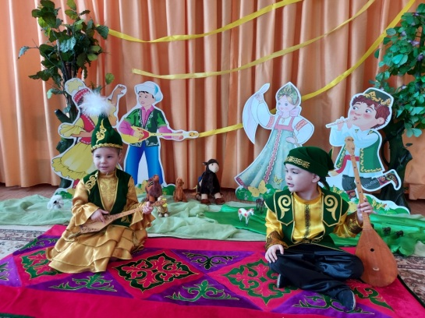
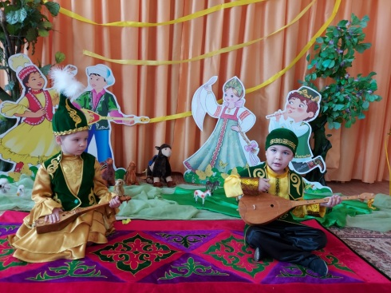
At the conclusion of the thematic week, under the motto "Heirs of the Great Steppe" in "Nursery - Tansholpan Garden," aitys were held among girls and boys of the older group, they continued the day with the flash mob "Balloons Air." For the further prosperity and development of the Kazakh language, children and kindergarten teachers on the Ak Zhol path transferred the study of the Kazakh language to children in England. All events were held at a good level, with the active participation of pupils, teachers and parents.

